Slide 1
This slide is hidden.
Insert the starting slides after this slide

Slide 2
This slide is hidden.
Insert the Entrance Hymn after this slide

Slide 3

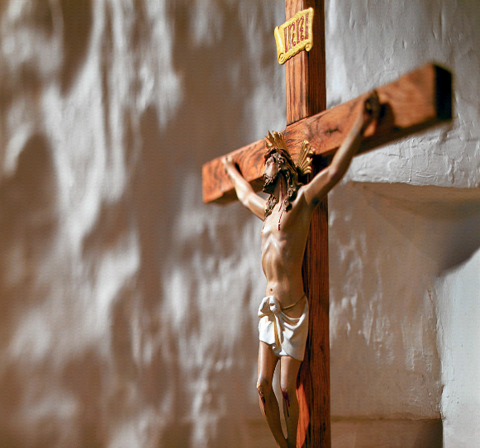
Welcome to St Michael’s
GOOD FRIDAY
You have entered a SACRED PLACE …
a SACRED TIME
Please be respectfully quiet as we prepare for our Celebration.
Please ensure all mobile phones are switched off.
Please place Project Compassion Boxes in basket at altar.
Notes:
Saturday 5.30PM First Sunday of Advent

Slide 4
The priests and ministers enter the Church in silence.

Slide 6
Responsorial Psalm
Father, I put my life in your hands.

Slide 8
Alleluia
Alleluia, alleluia,
alleluia, alleluia

Slide 9
Alleluia
Glory and praise to you, Lord Jesus Christ (2)

Slide 10
Christ Became Obedient unto death
Unto death a death upon the cross
Therefore God has raised Him to the heights
Giving Him a name above all names.

Slide 11
Glory and praise to you, Lord Jesus Christ (2)

Slide 13
The Passion of our
Lord Jesus Christ according
to John
You are invited to participate in the
Gospel by reading aloud the lines
that are in yellow.

Slide 14
N: …all with lanterns and torches and
weapons. Knowing everything that
was going to happen to him, Jesus
then came forward and said,
J: Who are you looking for ?
N: They answered,
C: Jesus the Nazarene.

Slide 15
N: Now Judas the traitor was standing
among them. When Jesus said, ‘I am
he’, they moved back and fell to the
ground. He asked them a second
time,
J: Who are you looking for?
N: They said,
C: Jesus the Nazarene.

Slide 17
N: …So Pilate came outside to them
and said,
O: What charge do you bring against
this man?
N: They replied,
C: If he were not a criminal,
we should not be handing him
over to you.

Slide 18
N: Pilate said,
O: Take him yourselves, and try him by
your own Law.
N: The Jews answered,
C: We are not allowed to put a man
to death.

Slide 20
O: I find no case against him. But
according to a custom of yours I
should release one prisoner at the
Passover; would you like me, then,
to release the king of the Jews?
N: At this they shouted:
C: Not this man, but Barabbas.

Slide 21
N: Barabbas was a brigand.
Pilate then had Jesus taken away
and scourged; and after this, the
soldiers twisted some thorns into a
crown and put it on his head, and
dressed him in a purple robe. They
kept coming up to him and saying,
C: Hail, king of the Jews !

Slide 22
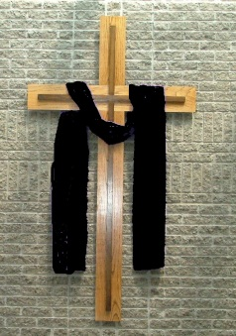
N: And they slapped him in the face.
Pilate came outside and said to them,
O: Look, I am going to bring him out to you to let you see that I find no case.
N: Jesus then came out wearing the crown of thorns and the purple robe. Pilate said,
O: Here is the man.
N: When they saw him the chief priests and the guards shouted,
C: Crucify him ! Crucify him !

Slide 23
N: Pilate said,
O: Take him yourselves and crucify him:
I can find no case against him.
N: The Jews replied,
C: We have a Law, and according to
the Law he ought to die, because
he has claimed to be the son of
God.

Slide 25
N: Jesus replied,
J: You would have no power over me if it had not been given you from above; that is why the one who handed me over to you has the greater guilt.
N: From that moment Pilate was anxious to set him free, but the Jews shouted,
C: If you set him free you are no friend of Caesar’s; anyone who makes himself king is defying Caesar.

Slide 26
N: It was Passover Preparation Day,
about the sixth hour. Pilate said to
the Jews,
O: Here is your king.
N: They said,
C: Take him away, take him away.
Crucify him !

Slide 27
N: Pilate said,
O: Do you want me to crucify your king ?
N: The chief priests answered,
C: We have no king except Caesar.

Slide 28
N: …‘Jesus the Nazarene, King of the Jews’. This notice was read by many of the Jews, because the place where Jesus was crucified was not far from the city, and the writing was in Hebrew, Latin and Greek. So the Jewish chief priests said to Pilate,
C: You should not write ‘King of the Jews’, but ‘This man said: I am King of the Jews’.

Slide 29
N: When the soldiers had finished crucifying Jesus they took his clothing and divided in into four shares, one for each soldier. His undergarment was seamless, woven in one piece from neck to hem; so the said to one another,
C: Instead of tearing it, let’s throw dice to decide who is to have it.

Slide 31
J: It is accomplished;
N: And bowing his head he gave up
His spirit.
All kneel and pause a moment.

Slide 33
Apostles Creed
I believe in God,
the Father almighty,
Creator of heaven and earth,
and in Jesus Christ, his only Son, our Lord,
(At the words that follow, up to and including the Virgin Mary, all bow.)

Slide 34
who was conceived by the Holy Spirit,
born of the Virgin Mary,
suffered under Pontius Pilate,
was crucified, died and was buried;
he descended into hell;

Slide 35
on the third day he rose again from the dead;
he ascended into heaven,
and is seated at the right hand of God the Father almighty;

Slide 36
from there he will come to judge the living and the dead.
I believe in the Holy Spirit,
the holy catholic Church,

Slide 37
the communion of saints,
the forgiveness of sins,
the resurrection of the body,
and life everlasting.
Amen.

Slide 39

Collection for the Holy Land
Support the people and places of the Holy Land.

Slide 40
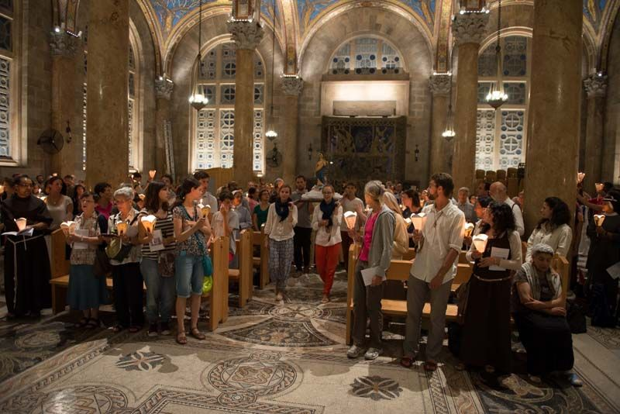
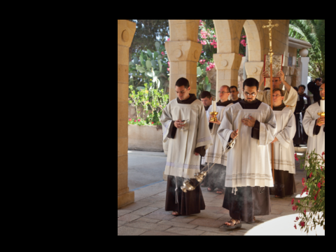
Parishes - staffed and served every day

Slide 41
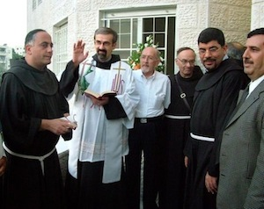
Jobs- housing & apartments for Christians
The blessing of a new housing project

Slide 42
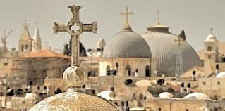
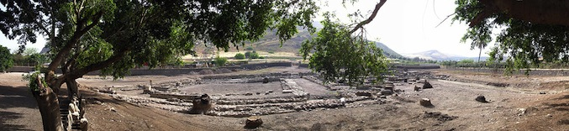
Shrines & Sanctuaries
Preserved and protected

Slide 43
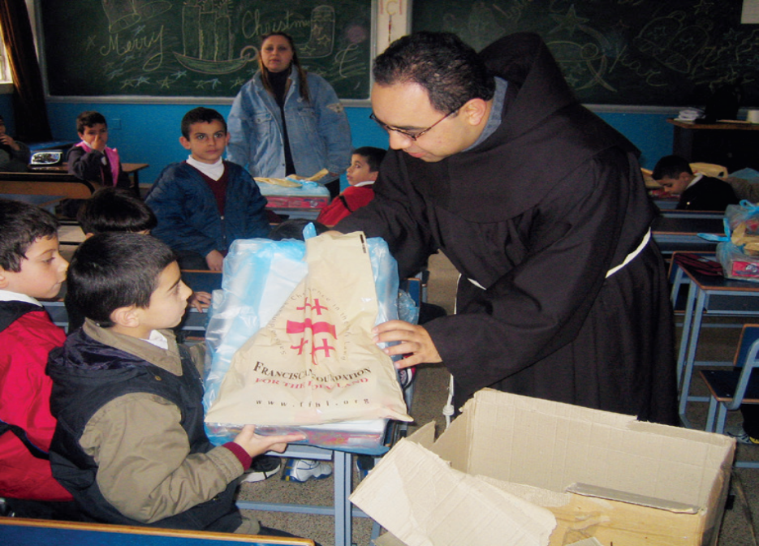
Academic institutions
Annual university scholarships
Grants
For students in difficult circumstances

Slide 44
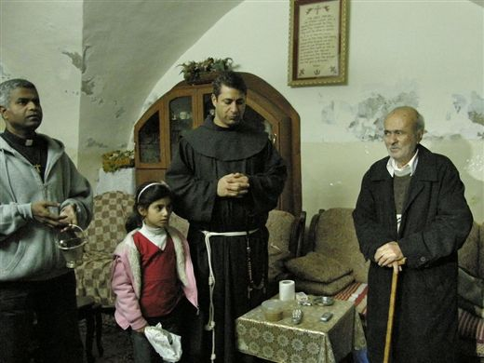
Care for the elderly poor

Slide 45
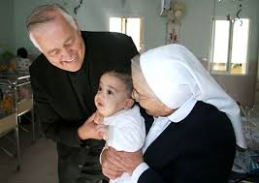
Homes for infirmed & orphaned
Holy Family Children's Home,
also known as the Creche of Bethlehem.

Slide 46
Thank you for your support!

Slide 48
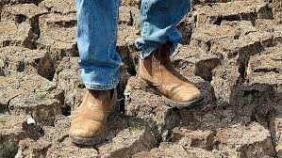
Veneration of the Cross
Ongoing drought in Rural NSW
O Come, let us adore.

Slide 49
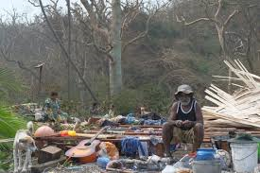
Veneration of the Cross
Cyclone Pam - Vanuatu
O Come, let us adore.

Slide 50
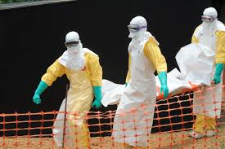
Veneration of the Cross
Ebola – West Africa
O Come, let us adore.

Slide 51
Kneel in silence

Slide 52
This slide is hidden.
Insert the Offertory Hymn after this slide.

Slide 53
Everything that Love can give
There upon the altar of His cross
The Lord has set His holy
Sacrifice for us

Slide 54
A willing Lamb with thorns
upon his brow
His heart of love still calls
you even now

Slide 55
High upon the altar of His cross
The Living Bread is freely broken there for us

Slide 56
The Living Wine flows from the
broken bough
His heart of love still calls you
even now

Slide 57
So remember every moment
that you live
He has given everything
that love can give

Slide 58
remember every moment
that you live
He’s given everything
that Love can give

Slide 59
There upon the altar of His cross
The Lord has set His holy
Sacrifice for us

Slide 60
A willing Lamb with thorns
upon his brow
His heart of love still calls
you even now

Slide 61
High upon the altar of His cross
The Living Bread is freely broken there for us

Slide 62
The Living Wine flows from the
broken bough
His heart of love still calls you
even now

Slide 63
So remember every moment
that you live
He has given everything
that love can give

Slide 64
remember every moment
that you live
He’s given everything
that Love can give

Slide 65
Everything that Love can give
There upon the altar of His cross
The Lord has set His holy
Sacrifice for us

Slide 66
A willing Lamb with thorns
upon his brow
His heart of love still calls
you even now

Slide 67
High upon the altar of His cross
The Living Bread is freely broken there for us

Slide 68
The Living Wine flows from the
broken bough
His heart of love still calls you
even now

Slide 69
So remember every moment
that you live
He has given everything
that love can give

Slide 70
remember every moment
that you live
He’s given everything
that Love can give

Slide 71
There upon the altar of His cross
The Lord has set His holy
Sacrifice for us

Slide 72
A willing Lamb with thorns
upon his brow
His heart of love still calls
you even now

Slide 73
High upon the altar of His cross
The Living Bread is freely broken there for us

Slide 74
The Living Wine flows from the
broken bough
His heart of love still calls you
even now

Slide 75
So remember every moment
that you live
He has given everything
that love can give

Slide 76
remember every moment
that you live
He’s given everything
that Love can give

Slide 77
We hail thee
We hail Thee Saviour and Lord
Thy Cross ever be adored.(2)

Slide 78
O Cross thou art the fountain
Of love and of liberty,
Shine down upon the millions
who search
for the light of Truth.

Slide 79
We hail Thee Saviour and Lord
Thy Cross ever be adored(2)

Slide 80
Look down upon the needy,
Confirm them in love and grace.
Thou art our true salvation
In Thee all our hope we place

Slide 81
We hail Thee Saviour and Lord
Thy Cross ever be adored(2)

Slide 82
Be thou our sign of victory
Redeem us from sin and strife
Renew in us Thy passion
And grant us eternal life.

Slide 83
We hail Thee Saviour and Lord
Thy Cross ever be adored (2)

Slide 84
Old Rugged Cross
On a hill far away
stood an old rugged cross,
the emblem of suffering and shame

Slide 85
and I love that old cross
where the dearest and best
for a world of lost sinners
was slain

Slide 86
So I'll cherish the old rugged cross,
till my trophies at last I lay down;

Slide 87
I will cling to the old rugged cross,
and exchange it some day
for a crown.

Slide 88
In that old rugged cross,
stained with blood so divine,
a wond - rous beauty I see,

Slide 89
for 'twas on that old cross
Jesus suffered and died,
to pardon and sanctify me

Slide 90
So I'll cherish the old rugged cross,
till my trophies at last I lay down;

Slide 91
I will cling to the old rugged cross,
and exchange it some day
for a crown.

Slide 92
To that old rugged cross
I will ever be true,
its shame and reproach gladly bear;

Slide 93
Then he'll call me some day
to my home far away,
where his glory forever I'll share

Slide 94
So I'll cherish the old rugged cross,
till my trophies at last I lay down;

Slide 95
I will cling to the old rugged cross,
and exchange it some day
for a crown.

Slide 96
We Are the Reason
As little children
We would dream of Christmas morn
And all the gifts and toys we thought we’d find

Slide 97
But we never realised
A baby born that blessed night
Gave us the greatest gift of our lives

Slide 98
We are the reason that He gave his life
We are the reason
That he suffered and died
To a world that was lost
He gave all He could give
To show us the reason to live

Slide 99
As the years went by
We learnt more about gifts
The giving of ourselves and what that means

Slide 100
On a dark cloudy day
A man hung crying in the rain
Because of love, because of love

Slide 101
We are the reason that He gave his life
We are the reason
That he suffered and died
To a world that was lost
He gave all He could give
To show us the reason to live

Slide 102
I’ve finally found a reason for living
It’s in giving every part of my heart to Him
In all that I do, every word that I say
I’ll be giving my all just for Him, for Him

Slide 103
We are the reason that He gave his life
We are the reason
That he suffered and died
To a world that was lost
He gave all He could give
To show us the reason to live

Slide 104
He is our reason to live (3)
He is my reason to live

Slide 105
Were you there
Were you there when they crucified my Lord?
Were you there when they crucified my Lord?

Slide 106
Oh, Oh! Sometimes
it causes me to tremble, tremble, tremble.
Were you there when they crucified my Lord?

Slide 107
Were you there when they nailed him to the tree?
Were you there when they nailed him to the tree?

Slide 108
Oh, Oh! sometimes
it causes me to tremble, tremble, tremble.
Were you there when they nailed him to the tree?

Slide 109
Were you there when they pierced him in the side?
Were you there when they pierced him in the side?

Slide 110
Oh, Oh! sometimes
it causes me to tremble, tremble, tremble.
Were you there when they pierced him in the side?

Slide 111
Were you there when they laid him in the tomb?
Were you there when they laid him in the tomb?

Slide 112
Oh, Oh! sometimes
it causes me to tremble, tremble, tremble.
Were you there when they laid him in the tomb?

Slide 113
He will carry you
There is no problem too big,
God cannot solve it,
There is no mountain too tall
He cannot move it.

Slide 114
There is no storm too dark,
God cannot calm it,
There is no sorrow too deep,
He cannot soothe it.

Slide 115
If he carried the weight of the world
Upon His shoulders
I know my brother that he will carry you.

Slide 116
If he carried the weight of the world
Upon His shoulders,
I know my sister that he will carry you.

Slide 117
He said, “Come unto me,
All who are weary,
and I will give you rest.”

Slide 118
There is no problem too big,
God cannot solve it,
There is no mountain too tall
He cannot move it.

Slide 119
There is no storm too dark,
God cannot calm it,
There is no sorrow too deep,
He cannot soothe it.

Slide 120
If he carried the weight of the world
Upon His shoulders
I know my brother that he will carry you.

Slide 121
If he carried the weight of the world
Upon His shoulders,
I know my sister that he will carry you.

Slide 122
He will carry you
He will carry you

Slide 123
Into your hands
Into your hands we commend our spirit, O Lord
Into your hands we commend our hearts
For we must die to ourselves in loving you
Into your hands we commend our love

Slide 124
O God, My God, Why have you gone from me
Far from my prayers, far from my cry
To you I call, but you never answer me
You send no comfort and I don't know why

Slide 125
Into your hands we commend our spirit,
O Lord
Into your hands we commend our hearts
For we must die to ourselves in loving you
Into your hands we commend our love

Slide 126
You've been my guide, since I was very young,
You showed the way, you brought relief.
But now I'm lonely, nobody's by my side,
Take heed my Lord, listen to my prayer.

Slide 127
Into your hands we commend our spirits O Lord
Into your hands we commend our hearts
For we must die to ourselves in loving you
Into your hands we commend our love

Slide 128
Veronica's song
He was despised and rejected by all
A man of sorrows, a man of grief
As one from whom people hide their faces
He was despised without esteem

Slide 129
But he was wounded for our transgressions
And he was tortured for our iniquities
And his chastisement has brought us healing
And by his scourging we are made whole

Slide 130
He had no beauty that we should desire him
His form disfigured a worm no man
His comeliness and his beauty had vanished
For he was scorned, despised, oppressed

Slide 131
But he was wounded for our transgressions
And he was tortured for our iniquities
And his chastisement has brought us healing
And by his scourging we are made whole

Slide 132
The very stone which the builders rejected
Is now and ever the corner stone
Let every knee bend to Jesus our Saviour
Each tongue confess that he is Lord

Slide 133
But he was wounded for our transgressions
And he was tortured for our iniquities
And his chastisement has brought us healing
And by his scourging we are made whole

Slide 134
On a Rugged Hill
On a rugged hill,
stood a rugged cross,
And upon that cross
there hung in shame

Slide 135
God’s beloved Son
Christ the lovely one
Who from heaven to
the sinner came

Slide 136
Calvary,
Rugged hill of sorrow
Where the Prince of Glory died for me

Slide 137
Wounded, crushed and broken hearted
Lone He suffered untold agony

Slide 138
Sinless, there He bore my burden
That from sinful shame
I might be free

Slide 139
Glorious day,
He took my sin away
On the cross of Calvary

Slide 140
On a rugged hill,
stood a mocking throng,
Scorning him who came
to save the lost

Slide 141
It was not in vain
That the Saviour came
To redeem His own
at priceless cost

Slide 142
Calvary,
Rugged hill of sorrow
Where the Prince of Glory died for me

Slide 143
Wounded,
crushed and broken hearted
Lone He suffered untold agony

Slide 144
Sinless,
there He bore my burden
That from sinful shame
I might be free

Slide 145
Glorious day,
He took my sin away
On the cross of Calvary

Slide 147
Priest: Pray my brothers and sisters,
that my sacrifice and yours may be
acceptable to God, the almighty Father.
All: May the Lord accept the sacrifice
at your hands for the praise and glory of his name, for our good and the good of all his holy Church.

Slide 148
Priest: The Lord be with you.
All: And with your spirit.
Priest: Lift up your hearts.
All: We lift them up to the Lord.

Slide 149
Priest: Let us give thanks to the
Lord our God.
All: It is right and just.

Slide 151
Holy
Holy, Holy, Holy Lord God of hosts,
Heaven and earth are full of your glory. Hosanna in the highest
Blessed is he who comes
in the name of Lord,
Hosanna in the highest.
Licence No. CCLI 312895

Slide 153
Memorial acclamation
Save us saviour of the world,
For by your cross and resurrection,
You have set us free

Slide 154
Memorial acclamation
When we eat this bread
And drink this cup
We proclaim your death O Lord
Until you come again

Slide 155
Memorial acclamation
We proclaim your death O Lord
And profess your resurrection
Until you come again
Licence No. CCLI 312895

Slide 157
Amen
Amen, amen, amen, amen.
Amen, amen, amen, amen.
Licence No. CCLI 312895

Slide 159
Peace
May the peace of the Lord be with you
With your friends and your family too
Let it be, let it grow
And everywhere you go
May the peace of the Lord follow you

Slide 160
Lamb of God
Lamb of God, lamb of God
You take away the sins of the world
Have mercy on us, lamb of God
Licence No. CCLI 312895

Slide 161
Lamb of God, lamb of God
You take away the sins of the world
Have mercy on us, lamb of God
Licence No. CCLI 312895

Slide 162
Lamb of God, lamb of God
You take away the sins of the world
Grant us, grant us peace
Licence No. CCLI 312895

Slide 164
Priest: Behold the Lamb of God, behold him who takes away the sins of the world.
Blessed are those called to the supper of the Lamb.
All: Lord, I am not worthy that you should enter under my roof, but only say the word and my soul shall be healed.

Slide 165
This slide is hidden.
Insert the Communion Hymns after this slide.

Slide 166
He came in love
Pure and holy, Son of God
Taking on the form of man
Left the glory of His throne
Came to bring salvations plan

Slide 167
Righteous Father, Holy One
Looking down on us in love
Gave to us His only Son
Sent with blessings from above

Slide 168
But we took Him
And we nailed Him
To a cross made of wood
And we raised it high
And dropped it in the ground where it stood

Slide 169
And the blood that flowed to the earth below
Bought forgiveness for the world
That had treated him so

Slide 170
Peace on earth Good will to men
At His birth angels sang
Love and mercy from the throne
Through the earth His message rang

Slide 171
But we took Him
And we nailed Him
To a cross made of wood
And we raised it high
And dropped it in the ground where it stood

Slide 172
And the blood that flowed to the earth below
Bought forgiveness for the world
That had treated him so

Slide 173
He came in love to bring us light in our darkness
He came in peace to bring release from our pain

Slide 174
He came with joy to bring us rest in our weariness
He came in love to bring us beauty again

Slide 175
But we took Him
And we nailed Him
To a cross made of wood
And we raised it high
And dropped it in the ground where it stood

Slide 176
And the blood that flowed to the earth below
Bought forgiveness for the world
That had treated him so

Slide 177
And the blood that flowed to the earth below
Bought forgiveness for the world
That had treated him so

Slide 178
Above All
(Lenny Leblanc and Paul Baloche)
Above all powers,
above all kings,
Above all nature
and all created things,

Slide 179
Above all wisdom
and all the ways of man,
You were here before
the world began.

Slide 180
Above all kingdoms,
above all thrones,
Above all wonders
the world has ever known,

Slide 181
Above all wealth and
treasures of the earth,
There’s no way to measure
what you’re worth.

Slide 182
Crucified,
laid behind a stone,
You lived to die,
rejected and alone.

Slide 183
Like a rose,
trampled on the ground,
You took the fall
And thought of me,
Above all

Slide 184
Crucified,
laid behind a stone,
You lived to die,
rejected and alone.

Slide 185
Like a rose,
trampled on the ground,
You took the fall
And thought of me,
Above all

Slide 186
Forgive me, Lord
How could it be that he so cared for me
To give up his life for my sake
No wrong he'd done, this was God's only Son
Who suffered and died in disgrace

Slide 187
If only he could hear me,
For now I know the way
I hurt him so.
Forgive me, Lord. Forgive me, Lord
I've been a fool for so long

Slide 188
Finally I see by your blood I am made free
Death can claim vict'ry no more
I am free

Slide 189
Lord I believe and in faith I now receive
Death can claim victory no more
I am free, I am free
I am free

Slide 190
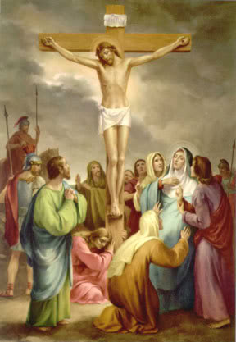
X
SILENCE PLEASE
The priests and ministers will leave the Church in silence.
At the conclusion of the liturgy you may venerate the cross privately.

Slide 191
SILENCE

Slide 193
This slide is hidden.
The next slide can be used for videos.
Insert the video into the slide.

Slide 195
This slide is hidden.
Insert the Recessional Hymns after this slide.

Slide 196
This slide is hidden.
Insert the final slide here.

